Slide 1
CS310 Operating Systems Lecture 30: Deadlock Avoidance, Banker’s Algorithm
Ravi Mittal
IIT Goa

Slide 2
Acknowledgements !
Contents of this class presentation has been taken from various sources. Thanks are due to the original content creators:
CS162, Operating System and Systems Programming, University of California, Berkeley
Book: Modern Operating System, Andrew Tanenbaum and Herbert Bos – Chapter 6
Book: Operating Systems: Principles and Practice: Thomas Anderson and Michael Dahlin, Volume II
Chapter 5.6

Slide 3
Reading
Book: Operating Systems: Principles and Practice: Thomas Anderson and Michael Dahlin, Volume II
Book: Operating System Concepts, 10th Edition, by Silberschatz, Galvin, and Gagne
Book: Modern Operating System, Andrew Tanenbaum and Herbert Bos – Chapter 6

Slide 4
Previous Classes

Slide 5
Necessary Conditions for Deadlock
There are 4 necessary conditions for deadlock to occur
If you can prevent any one of these conditions, you can eliminate the possibility of deadlock
Bounded Resources
There are a finite number of threads that can simultaneously use a resource
No preemption
Once a thread acquires a resource, its ownership cannot be revoked until the thread acts to release it
Wait while Holding
A thread holds one resource while waiting for another
Also called multiple independent requests
Circular Waiting
A set of waiting threads such that each thread is waiting for a resource held by another
Book: OS : Anderson and Dahlin

Slide 6
Resource-Allocation Graph (RAG) Examples
R₁
R₂
R₁
R₂
Model: Directed Graph
request edge
T_{i} → R_{j}
assignment edge
R_{j} → T_{i}
R₁
T₂
T₁
T₂
T₃
T₁
T₂
T₃
T₁
T₃
R₃
R₃
T₄
R₄
R₂
R₄
Simple Resource
Allocation Graph
Allocation Graph With Deadlock
Allocation Graph With Cycle, but
No Deadlock
Instead of thread T, we can also represent a process with a circle

Slide 7
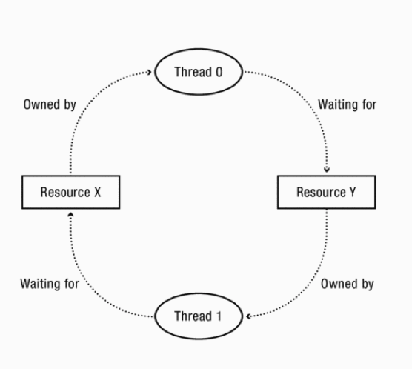
Analyzing - Resource Allocation Graph (RAG)
Consider several resources and only one thread can hold each resource at a time
Example: resources – one printer, one keyboard, one speaker
We can detect a deadlock by analyzing simple graph

Slide 8
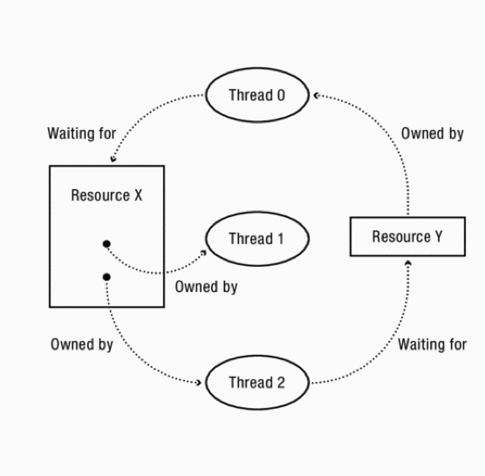
Multiple instances of one resource
Multiple instances of a resource can be represented as a resource with k interchangeable instances
Eg K equivalent printers as a node with k connections
Cycle is necessary but not sufficient condition for deadlock

Slide 9
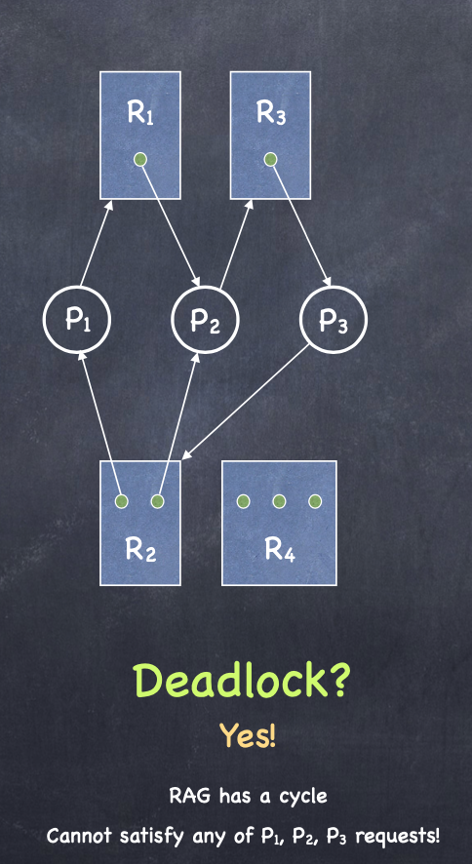
Example 2: RAG Reduction
CS4410 Operating Systems, Lecture on Deadlock

Slide 10

Example 2: RAG Reduction
P4
CS4410 Operating Systems, Lecture on Deadlock

Slide 11
Today we will study
Deadlock handling approaches
Deadlock Avoidance
Banker’s Algorithm

Slide 12
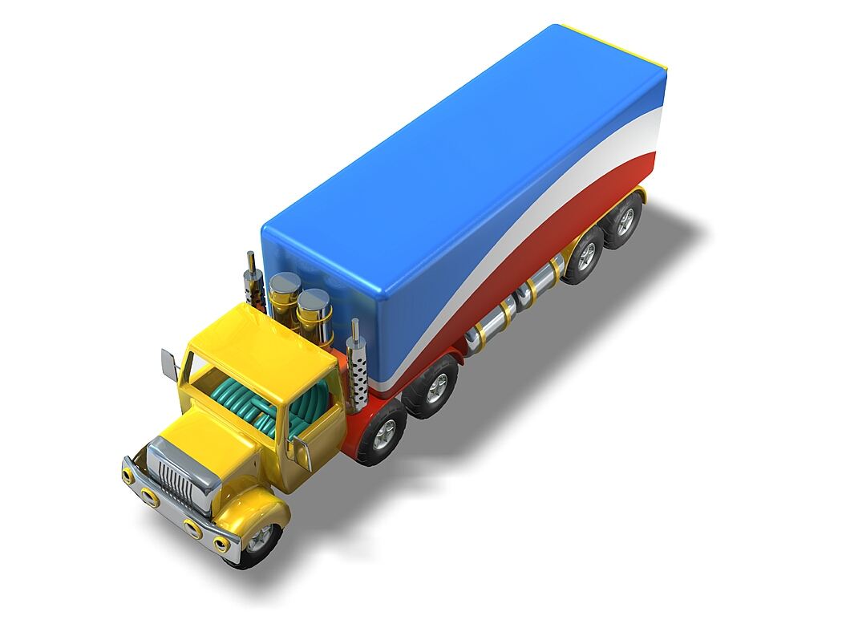

Deadlock Handling

Slide 13
Deadlock can be deadly!
Does a deadlock disappear on it’s own?
No. Unless a process is killed or forced to release a resource, deadlock exists
If a system is not deadlock at time T, is it guaranteed to be deadlock-free at T+1?

Slide 14
Deadlock can be deadly!
Does a deadlock disappear on it’s own?
No. Unless a process is killed or forced to release a resource, deadlock exists
If a system is not deadlock at time T, is it guaranteed to be deadlock-free at T+1?
No. Just by requesting a resource (never mind being granted one) a process can create a circular wait!

Slide 15
Handling Deadlocks
Ignore the problem
Pretend that deadlock never occurs in the system
This solution is used by most Operating Systems
Example: Linux, Windows
We can use a protocol to prevent or avoid deadlocks ensuring that system will never enter a deadlocked state
It is up to kernel and application developers to write programs that handle deadlocks
We allow the system to enter deadlocked state, detect it and recover from it

Slide 16
How Should a System Deal With Deadlock?
Three different approaches:
Deadlock avoidance
Dynamically delay resource requests so deadlock doesn’t happen
Thread must have enough information about resource requests and use during its lifetime
This knowledge can be used by OS to grant resources at appropriate time (now or later)
Deadlock prevention
Write your code in a way that it isn’t prone to deadlock
Deadlock recovery
Let deadlock happen, and then figure out how to recover from it
Modern operating systems:
Make sure the system isn’t involved in any deadlock
Ignore deadlock in applications
“Ostrich Algorithm” or deadlock denial
Kumar CS 162 at UC Berkeley, Summer 2020

Slide 17
Deadlock Avoidance

Slide 18
Deadlocks Avoidance

Slide 19
Deadlocks Avoidance
How do cars do it?
Never block an intersection
Must back up if you find yourself doing so

Slide 20
Deadlock Avoidance
Idea: When a thread requests a resource, OS checks if it would result in deadlock
If not, it grants the resource right away
If so, it waits for other threads to release resources
Example:
THIS DOES NOT WORK AT ALL TIME!!!!
Thread A
x.Acquire();
y.Acquire();
…
y.Release();
x.Release();
Thread B
y.Acquire();
x.Acquire();
…
x.Release();
y.Release();
Wait…
Blocks…
But it’s too late…
Kumar CS 162 at UC Berkeley, Summer 2020

Slide 21
A priori information Requirement
Additional a priori information availability
Example: Process P will request R1 and then R2 before releasing them; Process Q will require R2 and then R1
System can now take decision whether to allow the request, now, or later
Simplest and most useful model
Let each process declare the maximum number of resources of each type that it may need
Dynamically examine the resource-allocation state to ensure that there can never be a circular-wait condition
Resource-allocation state is defined by the number of available and allocated resources, and the maximum demands of the processes

Slide 22
Deadlock Avoidance: Three States
Safe state
System can delay resource acquisition to prevent deadlock
Unsafe state
No deadlock yet…
But threads can request resources in a pattern that unavoidably leads to deadlock
Deadlocked state
There exists a deadlock in the system
Deadlock avoidance: prevent system from reaching an unsafe state
Kumar CS 162 at UC Berkeley, Summer 2020

Slide 23
Safe State
When a process requests an available resource, system must decide if immediate allocation leaves the system in a safe state
System is in safe state if there exists a sequence <P₁, P₂, …, P_{n}> of ALL the processes in the systems such that for each P_{i}, the resources that P_{i} can still request can be satisfied by currently available resources + resources held by all the P_{j}, with j < i
That is:
If P_{i} resource needs are not immediately available, then P_{i} can wait until all P_{j} have finished
When P_{j} is finished, P_{i} can obtain needed resources, execute, return allocated resources, and terminate
When P_{i} terminates, P_{i +1} can obtain its needed resources, and so on
If no such sequence exists, then the system state is said to be unsafe
Book: OS book - Silberschatz, Galvin, and Gagne

Slide 24
Basic Facts
If a system is in safe state ⇒ no deadlocks
If a system is in unsafe state ⇒ possibility of deadlock
Avoidance ⇒ ensure that a system will never enter an unsafe state
A deadlocked state is an unsafe state
Not all unsafe states are deadlocks
An unsafe state may lead to a deadlock
As long as the state is safe, OS must avoid unsafe states
Book: OS book - Silberschatz, Galvin, and Gagne

Slide 25
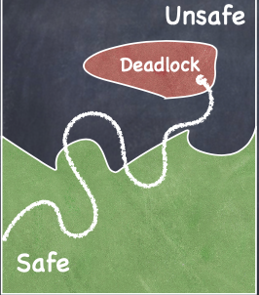
Safe, Unsafe, Deadlock State

Slide 26
Safe State Example
Suppose there are 12 tape drives
max need current usage could ask for
p0 10 5 5
p1 4 2 2
p2 9 2 7
3 drives remain
Current state is safe because a safe sequence exists: <p1,p0,p2>
p1 can complete with current resources
p0 can complete with current+p1 released resources
p2 can complete with current +p1+p0 released resources
Notes:
Show.

Slide 27
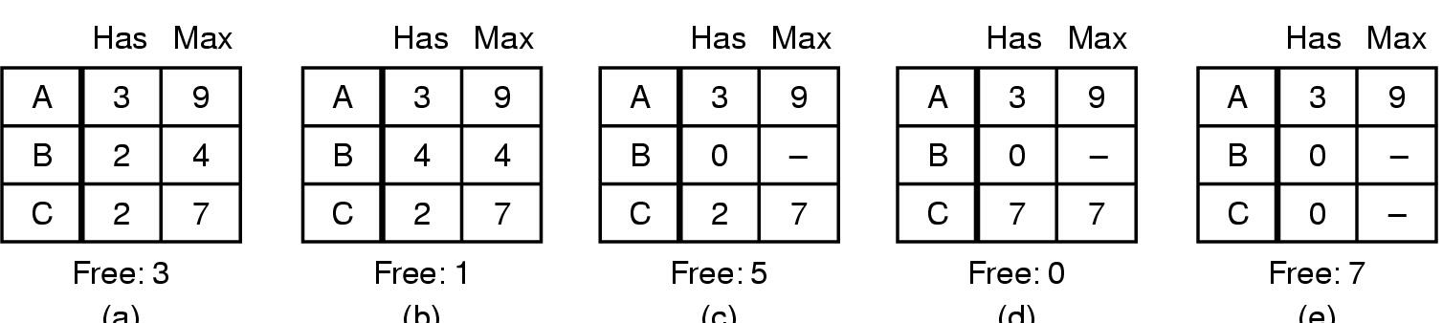

Safe and Unsafe States (1)
(a) (b) (c) (d) (e)
Is (a) safe?
Book: Modern OS – Tanenbaum , Hos

Slide 28
Safe and Unsafe States (1)
(a) (b) (c) (d) (e)
Is (a) safe? YES
Book: Modern OS – Tanenbaum , Hos

Slide 29

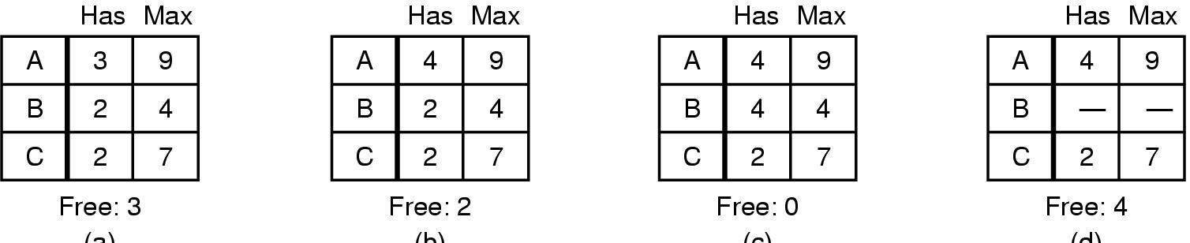

Safe and Unsafe States (2)
(a) (b) (c) (d)
Is state in (b) safe?
Book: Modern OS – Tanenbaum , Hos

Slide 30
Safe and Unsafe States (2)
(a) (b) (c) (d)
Demonstration that the sate in b is not safe
Book: Modern OS – Tanenbaum , Hos

Slide 31
Banker’s Algorithm E.W. Dijkstra & N. Habermann

Slide 32
Banker’s Algorithm
Suppose we know the worst case resource needs of processes in advance
A bit like knowing the credit limit on your credit cards. (This is why they call it the Banker’s Algorithm)
Observation: Suppose we just give some process ALL the resources it could need…
Then it will execute to completion.
After which it will give back the resources.
Like a bank: If Visa just hands you all the money your credit lines permit, at the end of the month, you’ll pay your entire bill

Slide 33
Banker’s Algorithm
So…
A process pre-declares its worst-case needs
Then it asks for what it “really” needs, a little at a time
The algorithm decides when to grant requests
It delays a request unless:
It can find a sequence of processes…
such that it could grant their outstanding need…
so they would terminate…
letting it collect their resources…
and in this way it can execute everything to completion!

Slide 34
Banker’s Algorithm for single resource
The algorithm checks to see if granting the request leads to an unsafe state
If so, the request is denied
If granting the request leads to a safe state, it is carried out
Example: 4 customers: A, B, C, D
Each is granted credit limit of a certain number of units
Where 1 unit (= 1K USD)
Banker knows that not all customers will need max credit
So he kept only 10 units (instead of 22 units)
Book: Modern OS – Tanenbaum , Hos

Slide 35
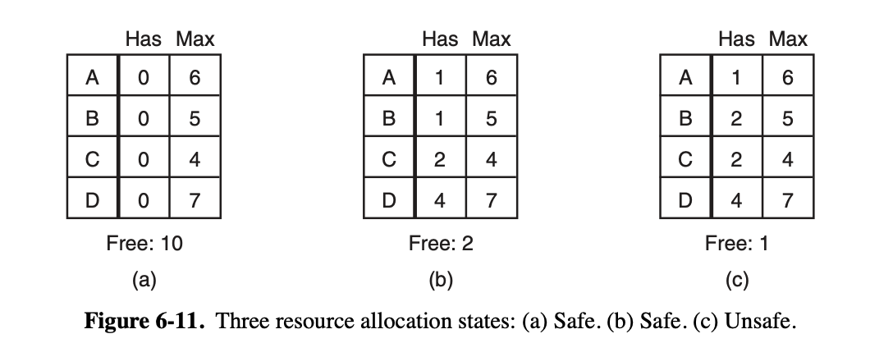

Banker’s Algorithm for single resource
In (b), system is safe
Now, OS must allocate resources to C to complete

Slide 36
Banker’s Algorithm for single resource
However, if it allocates resources to 1 resource to B
Unsafe state
Banker must give resources only when it leads to safe state

Slide 37
Lecture Summary
We have studied concepts of Safe state, Unsafe state and Deadlocked state
Deadlock must be avoided by
keeping track of which states are safe and which are unsafe
A safe state is one in which there exists a sequence of events that guarantee that all processes can finish
The banker’s algorithm avoids deadlock by not granting a request if that request will put the system in an unsafe state

